Slide 1


Bookstore Database Management System
IST-659 Database Management systems
Srinivas Reddy Pachika

Slide 2

Project Goals
Store and update available books information
Adding new books and their information
Generating daily sales report
View customer purchase history
Check the availability of a book

Slide 3

Major Data Questions
Date on which particular order is made
Customers purchase history
Customer Who purchased a particular Item
To check if a book is in stock

Slide 4
ER Diagram - Visio

Slide 5
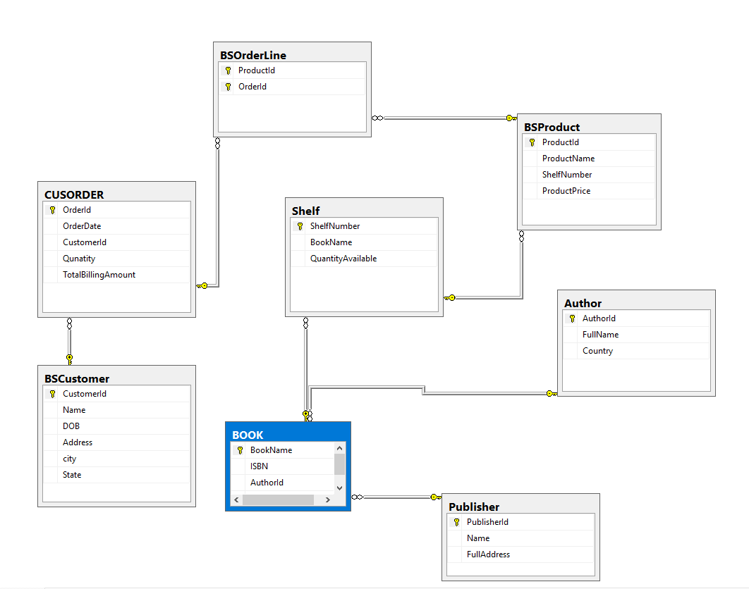
ER Diagram - SQL

Slide 6
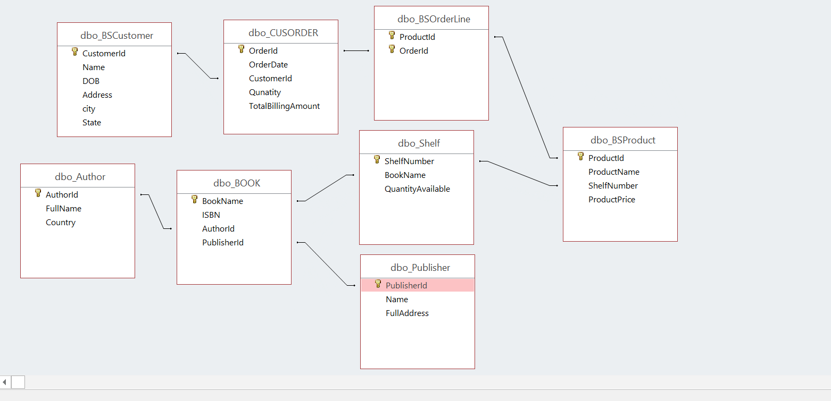
ER Diagram – Access Relationship Diagram

Slide 7
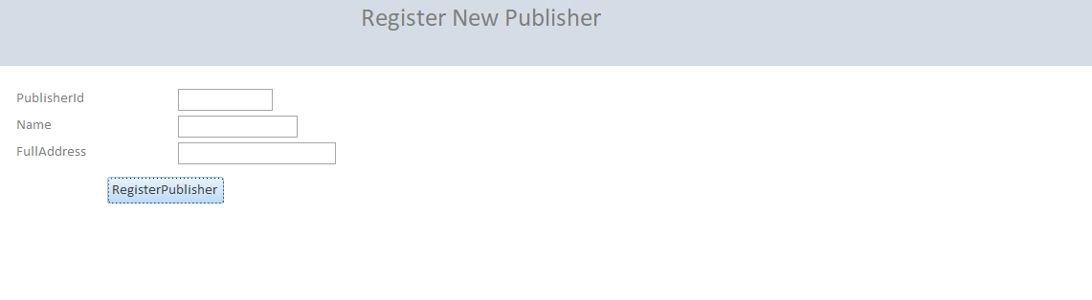
Register New Publisher Form

Slide 8
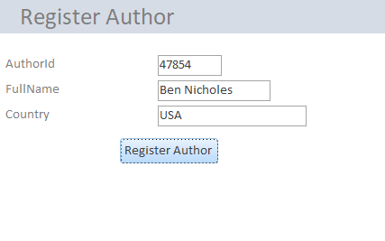
Register Author Form

Slide 9
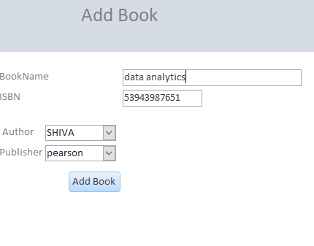
Add Book Form

Slide 10
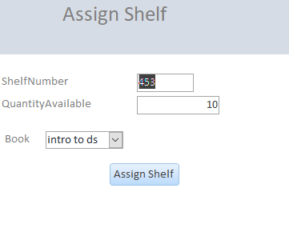
Assign Shelf Form

Slide 11
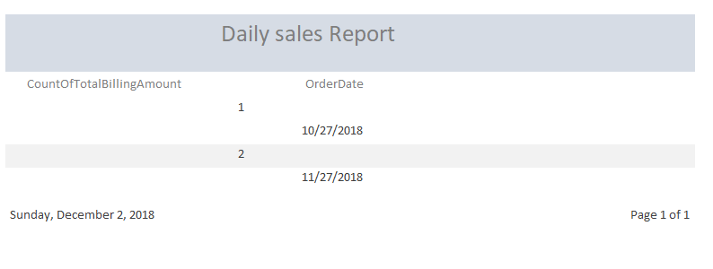
Sales Report

Slide 12
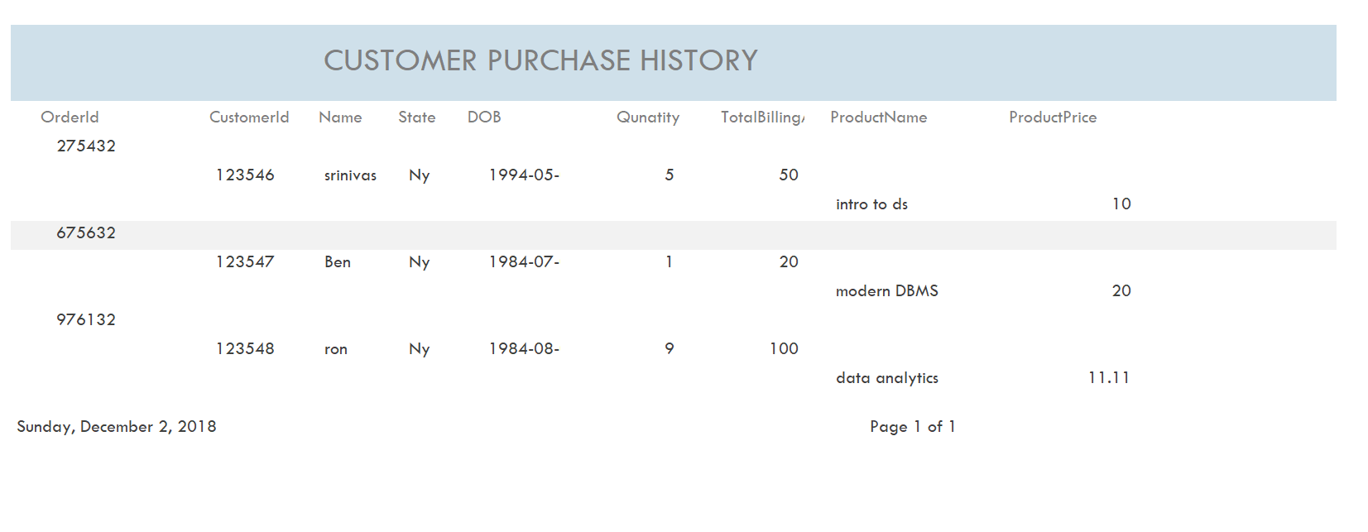
Customer Purchase History Report

Slide 13
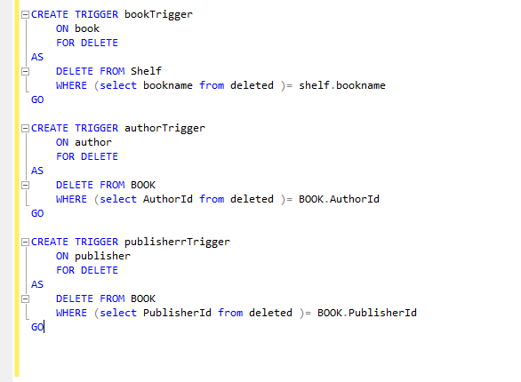
Trigger

Slide 14

Thank you

